Slide 1
Wilsonville Investment Now (WIN) Program Briefing – Planning Commission
November 12, 2020

Slide 2
History of TIF Zones in Wilsonville
Adopted in 2013, approved by voters
Six site-specific urban renewal areas
Property tax rebate incentive for qualifying investments
No development within the TIF Zones qualified for the incentive
Expired in November 2019

Slide 3
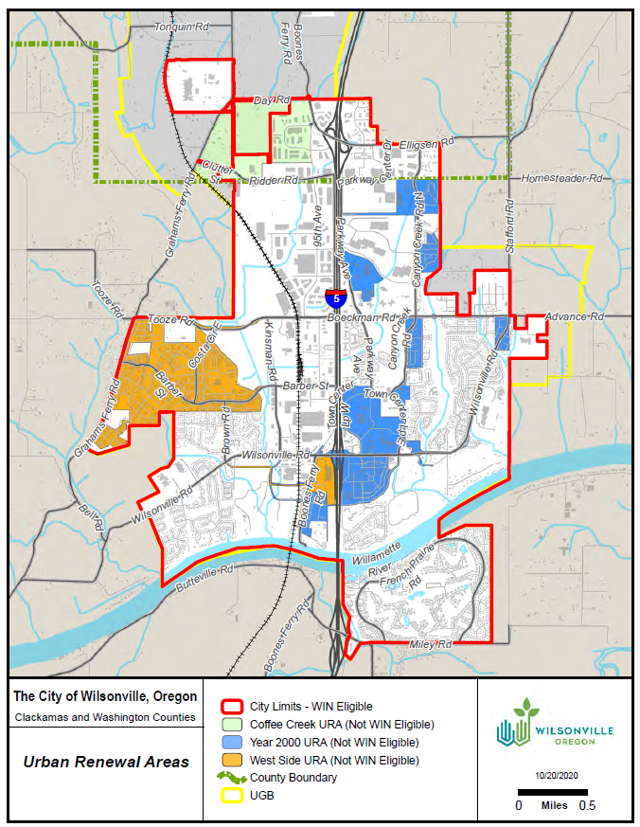
Urban Renewal in Wilsonville

Slide 4
TIF Zone Re-Launch
2019-20: redesigned as Wilsonville Investment Now (WIN) w/ flexible criteria and tiers of benefits
July 22, 2020: URA Task Force Meeting
Unanimous support
Diversity, Equity and Inclusion
Local Business Expansion (BRE)
Sept 10, 2020: Council supports Task Force recommendations
Oct 19, 2020: Council adoption of WIN Program

Slide 5
Final WIN Proposal
Modification to TIF Zones, not new program
URA tax rebates as development incentive
Council’s action adopted resolution to establish WIN Program Administrative Rules
Qualifying projects will require 4-month process to implement site-specific URA

Slide 6
Key Elements of WIN Program
Tax rebate
Eligibility criteria:
Value of new investment
Number of new employees
Compensation of new employees
DEI Commitments
Years of Operation in Wilsonville
Two tiers of benefits (4 and 7 years)
Citywide eligibility, except for existing URA areas
Notes:
Work session:
All of this has been covered before in previous Council discussions.
Changes from TIF Zone to WIN include:
“Extra Credit” DEI and Year of Operation in Wilsonville criteria
Two tiers of benefits
Citywide eligibility
City Council meeting:
Emphasis on tax rebate, not abatement, so qualifying companies must deliver on what they promised and pay their taxes before the City returns that revenue to them.

Slide 7
Benefits for Qualifying Businesses
Rebates 100% of TIF generated by the new investment
TIF only includes permanent rate levies
No impact on GO bonds or local option levies
Two tiers of qualifying benefits:
Full incentive: tax rebate for 7 years
Partial incentive: tax rebate for 4 years
Notes:
Council work session:
TIF revenue as a share of total taxes paid will vary from one tax code area to another.
28 total TCAs in all of Wilsonville.
Roughly 2/3 of total taxes paid are subject to TIF.
Limits the amount of incentive the City can offer via the WIN program (as opposed to Enterprise Zone or other State programs that exempt 100% of taxes).
Notable local option levies include:
West-Linn Wilsonville SD ($1.50)
Clackamas County Public Safety ($0.25)
TVF&R ($0.45)
Metro ($0.10)
Vector Control ($0.02)
Because TIF is only a portion of total taxes paid, the value of rebate over 4 to 7 years is roughly equal to the value of E-Zone benefits, which are offered for 3 and 5 years.
City Council meeting:
As an example, local option levies that go directly to fund the West Linn-Wilsonville School District will be untouched by the WIN program, and will have an immediate benefit for local classrooms.
The two-tiered approach allows the City to provide some benefit to a wider-range of potential developers, while maintaining the same high thresholds to qualify for the full-tier of benefits.

Slide 8
WIN Scoring System
Capital Investment | 1 point per $500,000 of investment
New Employment | 0 points: <100% of County average wage 0.2 points: 100% > 125% of County average wage 0.4 points: 125% > 150% of County average wage 0.6 points: >150% of County average wage
Local Business Tenure | 0.5 points for each verified year of business operations in the City of Wilsonville. Maximum of four (4) points.
Diversity, Equity, and Inclusion | 4 points for meeting two of the following criteria: Business Certification (Minority, Women, Disadvantaged, Veteran) Certified B Corporation DEI Procurement Plan DEI Workforce Development Plan DEI Company Program with at least 1 FTE On-site employer-provided childcare
Notes:
Businesses are scored across four criteria.
Capital investment and new employment provide the bulk of the points.
Scoring for new employment is dependent upon the average wage of employees, relative to the County average. Higher paying jobs provide more points, whereas jobs that pay less than the County average provide no points.
Local Business Tenure and DEI are ideas that came from Urban Renewal Task Force. Could provide applicants with up to 8 points, which could be enough to tip the scales from no benefits to partial, or from partial to full.
Local business tenure rewards local businesses that have been operating in Wilsonville for a long-time, as opposed to new businesses considering locating in the area.
DEI has a menu based approach with six sub-criteria listed. Businesses must commit to two of the six criteria to receive points for DEI.

Slide 9
WIN Scoring System
Less than 60 points | Does not qualify for benefits
60 to 79 points | Partial benefits (4 years)
80 points or above | Full benefits (7 years)
Notes:
As mentioned before, 80+ points required for full benefits. Based on scoring thresholds of original TIF Zone program: $25M, 75 jobs at 125% of county average compensation.
60 points as threshold for partial benefits. Example would be same project $25M, with wages equal to 125% of county average, but with 30 jobs instead of 75.

Slide 10
Thresholds: 100% to 125% Wages
B
D
C
A
Notes:
The next few slides illustrate the universe of potential investments that might occur, and whether or not they would qualify for WIN program incentives.
On these slides we’re only showing three variables: jobs, capital investment, and wages. And for that matter, wages are held constant on each slide.
In other words, these slides assume that the businesses shown are from out of town, and do not meet the DEI criteria.
The area in dark blue represents businesses that would qualify for the full incentive. Light blue represents businesses that would qualify for the partial incentive, and the dotted area show businesses that would not qualify for the incentive.
As an example, for a business that was paying employees between 100% and 125% of the county median wage, if it had $20M of investment, and 150 jobs, it would qualify for the partial incentive.
However, if that business still had the same wage level, and the same amount of capital investment, but instead had more jobs, say 350, it would now qualify for the full incentive.
Likewise, if that business had the same wage level, and the same 150 jobs, but invested more capital investment, say $50M, it would also qualify for the full incentive.
And just to complete the illustration, if this company were to reduce the amount of investment to say $10M, now it would no longer qualify for any incentive.
All of those examples assumed wages at 100% to 125% of the county median. However, the program gives more points per job if the wages are higher. So, if we look at businesses paying 125% to 150% of the countywide average…

Slide 11
Thresholds: 125% to 150% Wages
Notes:
We see how the areas of incentives shift.
At this wage level, a lower number of jobs will allow a business to qualify for the program at any given level of capital investment.

Slide 12
Thresholds: 150% and Up Wages
Notes:
Likewise, if wages exceed 150% of the county average.
The chart shifts again, and even fewer jobs are necessary for a business to qualify for incentives at any given level of investment.
For some specific numbers on how this might play out. A company making a $20M capital investment, would need 75 jobs to qualify for the full incentive at this high wage level. But at the lower wage level (100% of the countywide average), the $20M investment would require 200 jobs to achieve the same, minimum qualifying score.

Slide 13
Example Developments
 | A | B | C | D
Capital Investment | $20 M | $27 M | $27 M | $27 M
New Employment | 150 | 30 | 30 | 30
Average Salary | $70,000 | $50,000 | $50,000 | $90,000
Local Business Tenure (Years) | 0 | 0 | 8 | 8
Diversity, Equity, and Inclusion (Y/N) | No | No | Yes | Yes
Total Points | 100 | 54 | 62 | 80
Incentive | FULL | NONE | PARTIAL | FULL
Notes:
The last slides provided some visual examples of what business would and would not qualify for the program, but maybe not everyone is a visual learner… or maybe I’m bad at making and explaining charts. In any case, we also have a few specific examples to go over here.
Scenario A: This is based on a specific example that is in talks with the City of Wilsonville right now, hoping to be the first business to qualify for the WIN program. Reminder that the WIN program was only adopted by City Council last week, so the City has really hit the ground running with this program.
Scenario B: Hypothetical business. Nothing to sneeze at, but does not qualify for the incentive.
Scenario C: Same exact business: jobs, wages, capital investment; but now we assume it’s a company that’s been in business in Wilsonville for a long time (8 or more years), and the company commits to achieving the DEI requirements. With those additional criteria met, the company receives 8 additional points, which is enough to tip the scales from no incentive to partial incentive.
Scenario D: Lastly, we look at the same hypothetical business as Scenario C. Except this time, instead of paying salaries that are on par with the average county wage, it’s now offering high-wage jobs that exceed 150% of the county average. That’s enough to boost the total score up to 80 points which qualifies for the full incentive.

Slide 14
Tax Rates Included
Example Tax Code Area: URA receives 67% of total taxes paid
 | Permanent Rates | Local Option Levies | GO Bonds | Total | Urban Renewal Eligible
City of Wilsonville | $2.5206 |  |  | $2.5206 | $2.5206
Clackamas County | $2.9016 | $0.2480 | $0.0949 | $3.2445 | $2.9016
Tualatin Valley Fire & Rescue | $1.5252 | $0.4500 | $0.0973 | $2.0725 | $1.5252
Port of Portland | $0.0701 |  |  | $0.0701 | $0.0701
Metro | $0.0966 | $0.0960 | $0.4702 | $0.6628 | $0.0966
Vector Control | $0.0065 | $0.0250 |  | $0.0315 | $0.0065
Clackamas Community College | $0.5582 |  | $0.1753 | $0.7335 | $0.5582
West Linn – Wilsonville SD | $4.8684 | $1.5000 | $2.9621 | $9.3305 | $4.8684
Clackamas ESD | $0.3687 |  |  | $0.3687 | $0.3687
Total | $12.9159 | $2.3190 | $3.7998 | $19.0347 | $12.9159
Notes:
That was a lot of information on what it takes to qualify for the incentive.
Now we’ll talk a little about what that incentive is actually worth.
The WIN Program is implemented through urban renewal. That means that unlike the State Enterprise Zone program, the WIN Program cannot offer a rebate on 100% of the taxes paid. Instead, the WIN program can only rebate the portion of taxes that are subject to tax increment financing.
Oregon statutes governing urban renewal stipulate that new urban renewal areas only calculating tax increment using the permanent rate levies. All general obligation bond, and local option levies are excluded.
Thus, for this example tax code area in the City of Wilsonville, just about 2/3 of the total tax bill is derived from permanent rate levies and would be subject to the WIN program. The other 1/3 would be paid by the qualifying businesses, but would not be part of the rebate.
While this does reduce the value of the overall rebate, it also ensures that overlapping taxing districts with important local option levies receive some immediate tax benefit from the development. In Wilsonville, this includes the school district, the fire district, and the county public safety levy, among others.

Slide 15
Example A – Annual Tax Rebate
Improvement Value | $20,000,000
Net AV from Improvement | $12,700,000
Total Taxes Paid | $242,000
Total Taxes to URA (Rebate Received) | $164,000
% of Taxes Paid | 68%
Notes:
What does the value of this rebate look like for a specific example?
If we go back to Example A from a couple of slides ago. The business in talks with the City now regarding an investment of $20M or more.
Based on the current changed property ratio in the County, this would result in an increase in assessed value of $12.7M. This is a good reminder that the real market value of capital investments is not the same as the assessed value of those improvements, given Oregon’s vexing property tax system.
Given the tax rates showed on the previous slide, this property would pay $242,000 of taxes in its first year.
Of that $242,000, $164,000 would be subject to the WIN program and would be rebated to the business. Again, this is about 2/3 of the total tax bill.
As for how much the value of this rebate increases or decreases in future years; that depends on the specific composition of the capital investments. Were these investments in real property? Physical buildings, site improvements to the land? If so, we could expect 3% growth in value in future years. However, a part of the investments are likely to be machinery and equipment. That personal property typically depreciates over time, with the pace of that depreciation depending on the specific type of machinery and equipment in question.

Slide 16
Program Application
Capacity for 143 acres
Clear and objective application
Must be approved prior to construction
City/applicant meet for a preauthorization conference
Development Agreement
Adopt new UR Plan for each investment
 | URA Area Cap Test
District | Acreage | % of City
Year 2000 Plan | 449 | 8.9%
West Side Plan | 411 | 8.1%
Coffee Creek | 258 | 5.1%
Combined | 1,118 | 22.2%
Total City | 5,046 | 100.0%
Notes:
As for the process itself. Once a business has submitted an application form..
City and applicant would need to enter into a legal development agreement, stipulating what each party is committing to (i.e., how many jobs, how much new investment, etc.).
While this process is intended to be streamlined to be attractive to potential developers, it is not automatic and does require a meaningful public process to adopt the site-specific urban renewal plans.
Elaine Howard will talk more about this in a few moments.

Slide 17
Timeline for Template Plan
Month 1 | Urban Renewal Agency Meeting
Month 2 | Planning Commission Meeting
Month 3 | City Council Meetings 1 and 2
Month 4 | Plan Effective
Consult and Confer (45 days Minimum)

Slide 18
Components of a Report
Existing Conditions
Physical
Social
Economic
Project Description
Financial Analysis
$$ allocations and timing on projects
Administration
Impact on Taxing Districts
Overall chart on acreages and assessed value in City

Slide 19
Components of a Plan
Goals and Objectives
Project description
Amendments
Maximum Indebtedness
Relationship to Local Objectives

Slide 20
Planning Commission’s Role
Site Specific URA - Comp Plan Findings
Coffee Creek Urban Renewal Area
Citizen Engagement
Urban Growth Management
Public Facilities and Services
Transportation
Economic Development
WIN Program
Citizen Engagement
Industrial Development
Economic Development

Slide 21
Questions?
Thank you!

