Slide 1
Middle Housing Code Update
Plan and Code Audit
Wilsonville Planning Commission
Work Session
November 12, 2020

Slide 2
Topics for Discussion
Focus on Key Issues
Other code/plan audit topics, as needed

Slide 3
Project Lenses
Compliance
Usability and practicality
Equitable housing outcomes

Slide 4
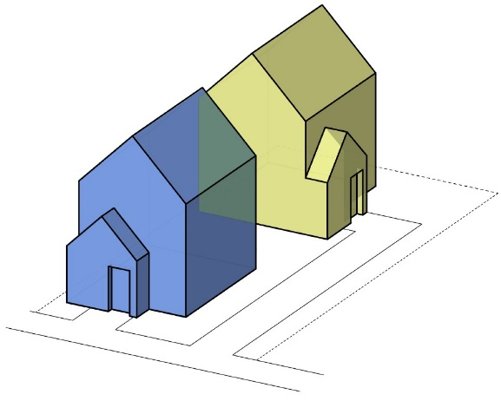
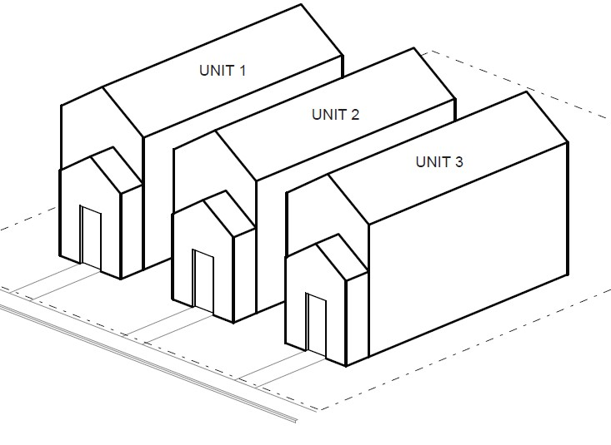
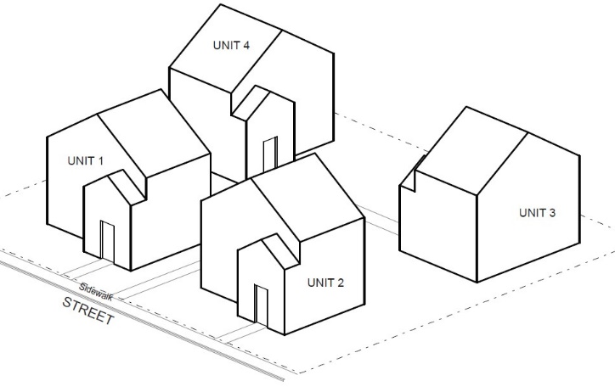
Issue #1: Detached Plexes
Should the City allow duplexes, triplexes, and quadplexes to be detached on a lot?

Slide 5
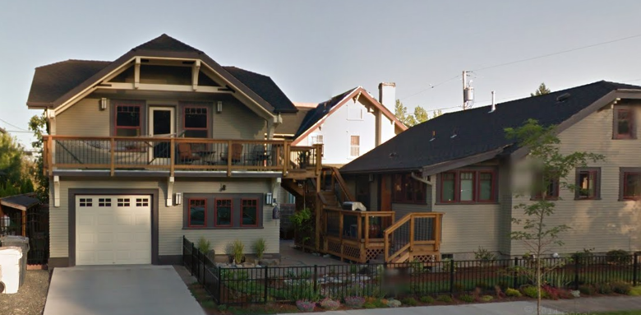
Issue #1: Detached Plexes
Pros
Promotes preservations of existing SFDs
Increased flexibility for unusual site configurations or constraints
Can resemble single-family detached homes
Cons
Conventional understanding and typical definition is attached units
Adds complexity to the code

Slide 6
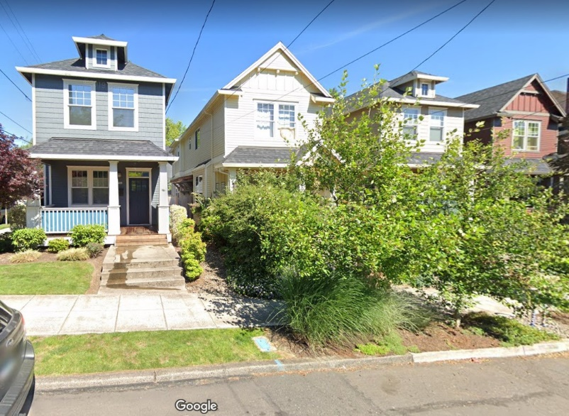
Issue #1: Detached Plexes
Example: City of Bend allows detached duplexes and triplexes
Preliminary Recommendation: Allow detached plexes

Slide 7
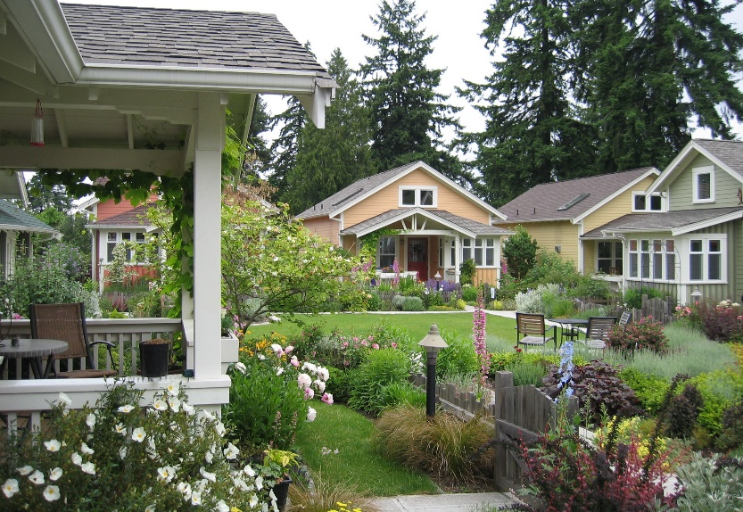
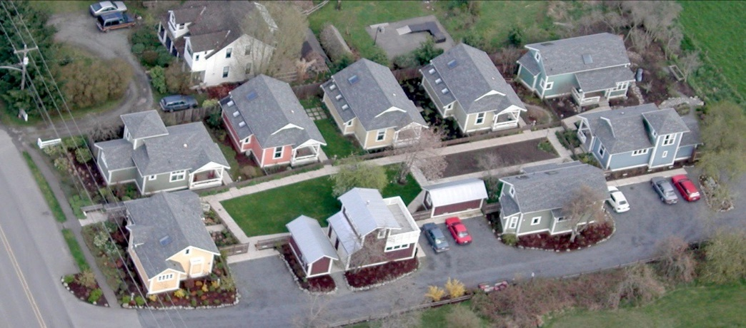
Issue #2: Cottage Clusters on Individual Lots
Should the City allow cottage clusters on separate, individual lots?

Slide 8
Issue #2: Cottage Clusters on Individual Lots
Pros
Desirable option for builders – lots can be owned “fee simple”
More paths for homeownership
Cons
Clear and objective land division standards may be challenging
Code needs to address shared tracts, cross-access easements, etc.

Slide 9
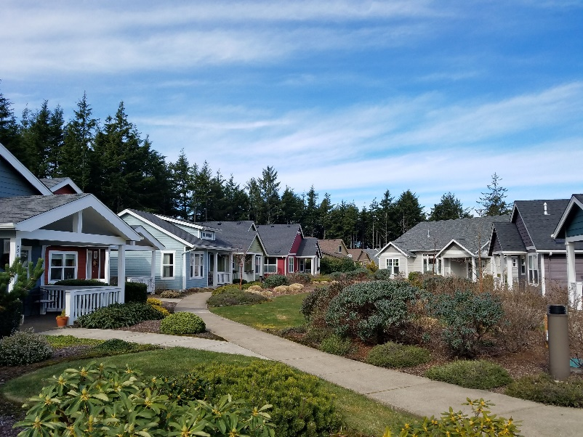
Issue #2: Cottage Clusters on Individual Lots
Examples:
Oregon City allows on either individual lots or single lot
Milwaukie allows on individual lots only
Tigard allows on single lot only
Preliminary Recommendation:
Allow for both situations

Slide 10
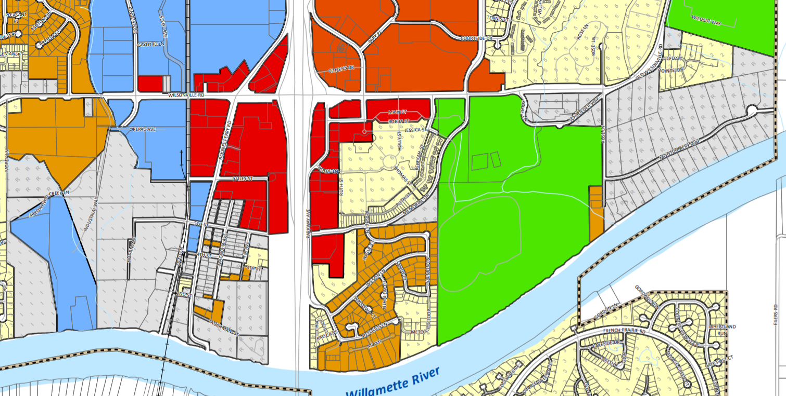
Issue #3: RA-H Zoned Lots
How should the City address middle housing on smaller lots zoned RA-H with a residential Comprehensive Plan designation?

Slide 11
Issue #3: RA-H Zoned Lots
Development on RA-H requires rezoning (except for single-family dwelling)
Significant barrier to middle housing:
Requires DRB and City Council approval
Adds to time and cost
Introduces uncertainty and risk
Neighbors receiving notice have little ability to influence outcomes

Slide 12
Issue #3: RA-H Zoned Lots
Options:
Legislative rezoning for residential RA-H lots
Conditional rezoning pending property owner approval
Amend RA-H zone to permit middle housing without a rezone
Streamline or expedite the required process for Zoning Map amendments

Slide 13
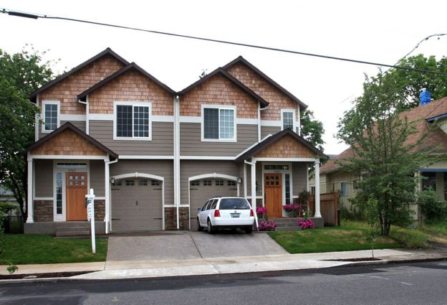
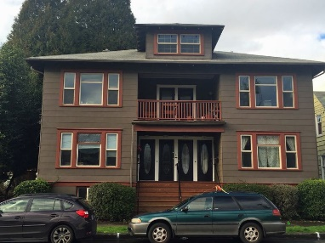
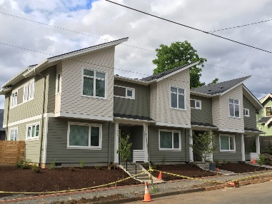
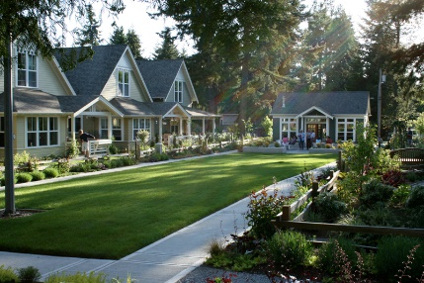
Other Topics
Housing definitions
Density exceptions
Review procedures

Slide 14
Other Topics continued
Residential development standards (general)
Design standards
Villebois updates
RN zone updates
Old Town updates

Slide 15
Other Topics continued
Status of old planned development approvals
Parking
Private streets
Site design review exception

